Slide 1
Lập trình ứng dụng mobile (Spring 2020)
Session 2: Installation
Instructor: Nguyen Tri Nhan

Slide 2
Contents
Install the Ionic CLI
Start an App
Run the App
Ionic apps are created and developed primarily through the Ionic command-line utility. The Ionic CLI is the preferred method of installation, as it offers a wide range of dev tools and help options along the way. It is also the main tool through which to run the app and connect it to other services, such as Ionic Appflow.

Slide 3
Install the Ionic CLI
Before proceeding, make sure your computer has Node.js installed. See these instructions to set up an environment for Ionic.
Install the Ionic CLI with npm:
If there was a previous installation of the Ionic CLI, it will need to be uninstalled due to a change in package name.
npm install -g @ionic/cli
npm uninstall -g ionic npm install -g @ionic/cli

Slide 4
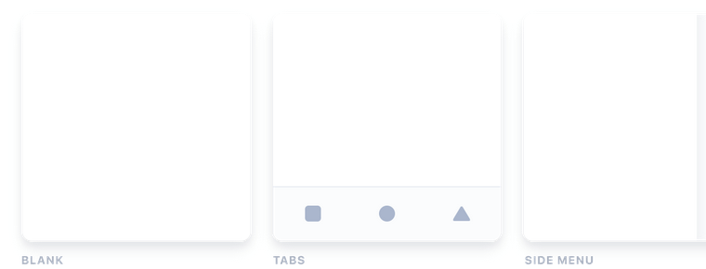
Start an App
Create an Ionic app using one of the pre-made app templates, or a blank one to start fresh. The three most common starters are the blank starter, tabs starter, and sidemenu starter. Get started with the ionic start command:
ionic start myApp tabs

Slide 5
Run the App
The majority of Ionic app development can be spent right in the browser using the ionic serve command:
cd myApp
ionic serve

Slide 6
Ionic Packages
Contents
Ionic Framework CDN
Ionic + Angular
Ionic + React
Ionicons CDN
Ionic provides different packages that can be used to quickly get started using Ionic Framework or Ionicons in a test environment, Angular, any other framework, or none at all.

Slide 7
Ionic Framework CDN
Ionic Framework can be included from a CDN for quick testing in a Plunker, Codepen, or any other online code editor!
It's recommended to use jsdelivr to access the Framework from a CDN. To get the latest version, add the following inside the <head> element in an HTML file, or where external assets are included in the online code editor:
<script type="module" src="https://cdn.jsdelivr.net/npm/@ionic/core/dist/ionic/ionic.esm.js"></script>
<script nomodule src="https://cdn.jsdelivr.net/npm/@ionic/core/dist/ionic/ionic.js"></script>
<link rel="stylesheet" href="https://cdn.jsdelivr.net/npm/@ionic/core/css/ionic.bundle.c

Slide 8
Ionic + Angular
When using Ionic Framework in an Angular project, install the latest @ionic/angular package from npm. This comes with all of the Ionic Framework components and Angular specific services and features.
npm install @ionic/angular@latest –save
Each time there is a new Ionic Framework release, this version will need to be updated to get the latest features and fixes. The version can be updated using npm, as well.
For adding Ionic to an already existing Angular project, use the Angular CLI's ng add feature.
ng add @ionic/angular
This will add the necessary imports to the @ionic/angular package as well as add the styles needed.

Slide 9
Ionic + React
To add Ionic to an already existing React project, install the @ionic/react and @ionic/react-router package.
npm install @ionic/react
npm install @ionic/react-router

Slide 10
Environment Setup
Contents
Terminal
Node & npm
Git
To get started with Ionic Framework, the only requirement is a Node & npm environment.
Of course, a code editor is also required. VS Code is recommended. VS Code is a free, batteries-included text editor made by Microsoft.

Slide 11
Terminal
Much of Ionic development requires familiarity with the command line. If you're new to the command line, see this Blog Post for a quick introduction.
In general, we recommend using the built-in terminals. Many third-party terminals work well with Ionic, but may not be supported.
For Windows, Command Prompt and PowerShell are supported. WSL is known to work with Ionic, but may not be supported.
For macOS, the built-in Terminal app is supported.
Git Bash (from git-scm.com) does not support TTY interactivity and is not supported by Ionic.

Slide 12
Node & npm
Almost all tooling for modern JavaScript projects is based in Node.js. The download page has prebuilt installation packages for all platforms. We recommend selecting the LTS version to ensure best compatibility.
Node is bundled with npm, the package manager for JavaScript.
To verify the installation, open a new terminal window and run:
node --version
npm --version
Permission errors are common on macOS when installing global packages with npm. If you get an EACCES error, see Resolving Permission Errors.

Slide 13
Git
Although not required, the version control system Git is highly recommended.
Git is often accompanied by a Git Host, such as GitHub, in which case additional setup is required. Follow the tutorial from the Git Host's documentation to set up Git:
GitHub: Set up Git
GitLab: Installing Git
Bitbucket: Install Git
Otherwise, follow the official installation instructions. The command-line utility can be downloaded from the download page.
To verify the installation, open a new terminal window and run:
git --version

Slide 14
iOS Setup
Contents
Xcode
Cordova Setup
To target iOS, some additional environment setup is required. Unfortunately, iOS apps can only be created on macOS.

Slide 15
Xcode
Xcode is the IDE for creating native iOS apps. It includes the iOS SDK and Xcode command-line tools. Xcode can be downloaded for free with an Apple account. It can also be installed through the App Store.
Once Xcode is installed, make sure the command-line tools are selected for use:
xcode-select --install

Slide 16
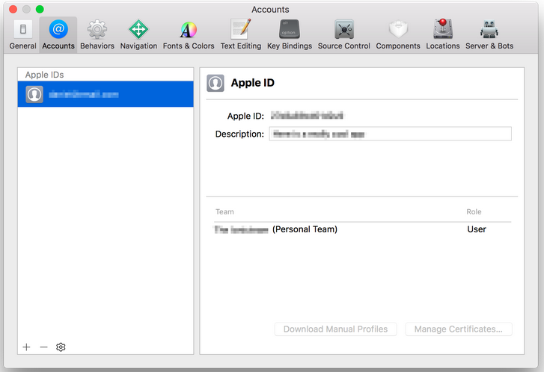
Setting up a Development Team
All iOS apps must be code signed, even for development. Luckily, Xcode makes this easy with automatic code signing. The only prerequisite is an Apple ID.
Open Xcode and navigate to Xcode » Preferences » Accounts. Add an Apple ID if none are listed. Once logged in, a Personal Team will appear in the team list of the Apple ID.

Slide 17
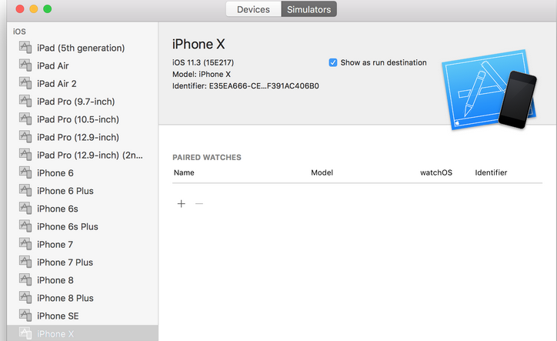
Creating an iOS Simulator
The iOS simulator emulates iOS devices on Macs. The following documentation is a quick way to get the iOS simulator set up. For more information, see Apple's documentation.
Open Xcode and navigate to Window » Devices and Simulators. Create an iPhone 11 simulator if one does not already exist.

Slide 18
Cordova Setup
Additional setup is required for Cordova to support programmatic builds. This section is not necessary for Capacitor.

Slide 19
ios-sim & ios-deploy
The ios-sim and ios-deploy are utilities that deploy apps to the iOS simulator and iOS devices during development. They can be installed globally with npm.
npm install -g ios-sim
brew install ios-deploy

Slide 20
Android Setup
Contents
Android Studio
Cordova Setup
To target the Android platform, some additional environment setup is required. Android apps can be created on Windows, macOS, and Linux.

Slide 21
Android Studio
Android Studio is the IDE for creating native Android apps. It includes the Android SDK, which will need to be configured for use in the command line.
Android Studio is also used to create Android virtual devices, which are required for the Android emulator. Ionic apps can also be launched to a device.
We don't recommend using Android Studio for developing Ionic apps. Instead, it should only really be used to build and run your apps for the native Android platform and to manage the Android SDK and virtual devices.

Slide 22
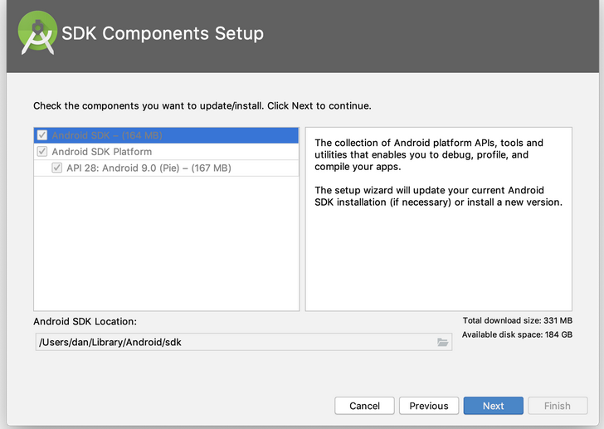
Installing the Android SDK
Once installed, open Android Studio. The IDE should detect that the Android SDK needs to be installed. In the SDK Components Setup screen, finish installing the SDK. Keep note of the Android SDK Location.

Slide 23
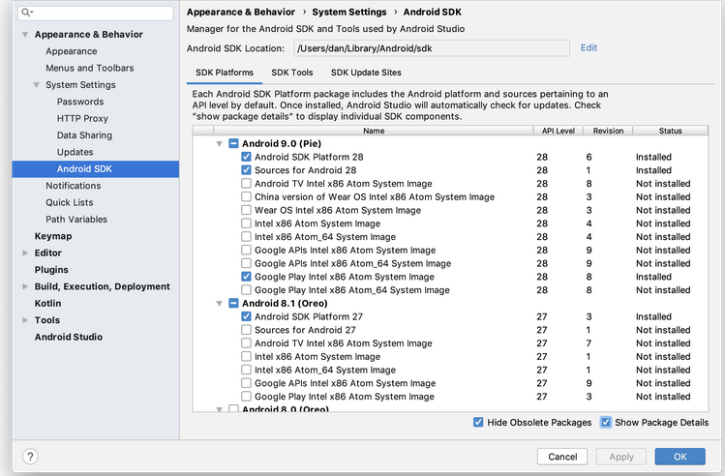
By default, the latest stable SDK Platform is installed, which includes a collection of packages required to target that version of Android.
To install system images and other minor SDK platform packages, you may need to ensure Show Package Details is checked at the bottom of the SDK Manager.
For future reference, the Android SDK can be managed with Android Studio in the Configure » SDK Manager menu of the Android Studio welcome screen or Tools » SDK Manager inside Android projects.

Slide 26
Question???

